Slide 1
DATA MINING FOR STOCKS PREDICTION
WQD 180077
ZHU TING
https://youtu.be/2Ip9BuLU1aE

Slide 2
Data Cleaning technique
Stock price
Join -----------Transpose long to wide Index by Date ( Time Series)
Clean-----Fill Missing Data Backfill forward will interpolate
Machine learning ----
Alliance Bank Berhad
Scale / split
Model

Slide 3
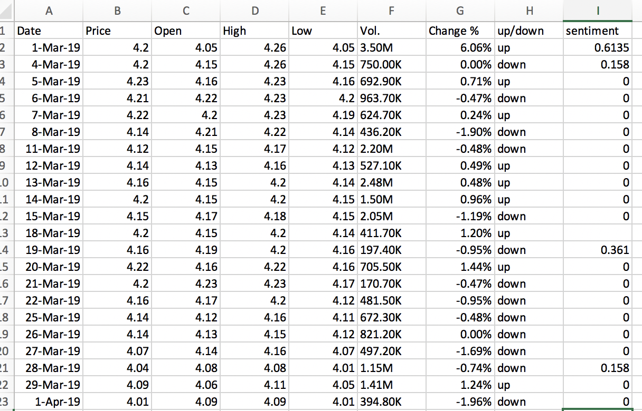
Dataset

Slide 4
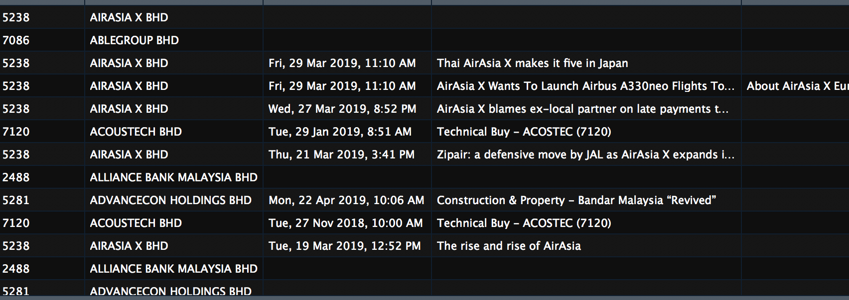
Sentiment analysis

Slide 5
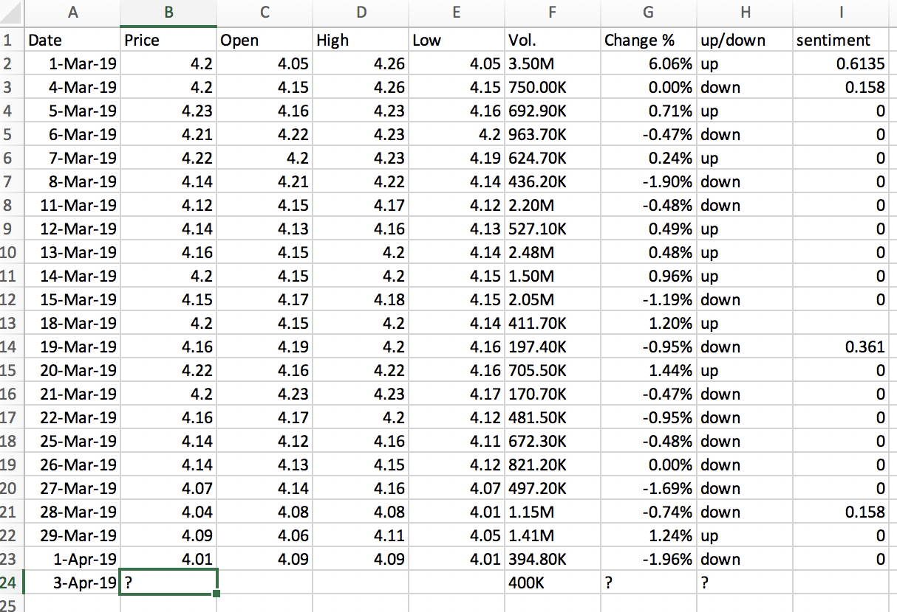
Goals
Estimate Next Business Day stock price up/down

